Slide 1
Area of a Triangle

Slide 2
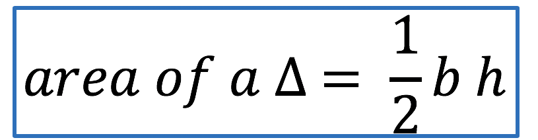
Area of a triangle
h
h
b
b

Slide 3
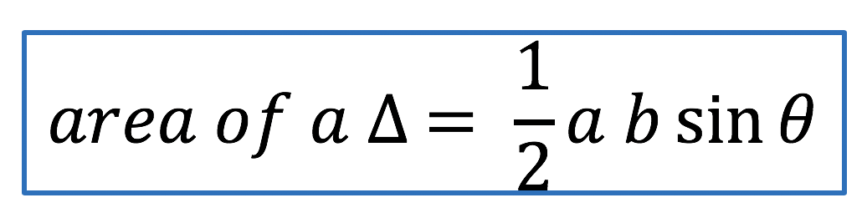

C
$$θ$$
b
a
B
A

Slide 4
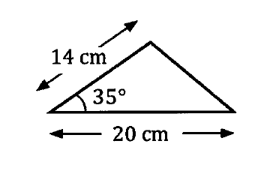
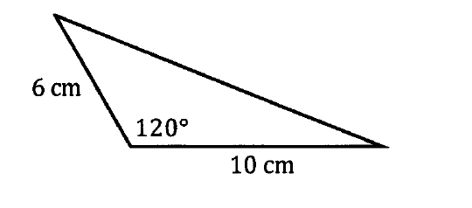












Examples

Slide 5
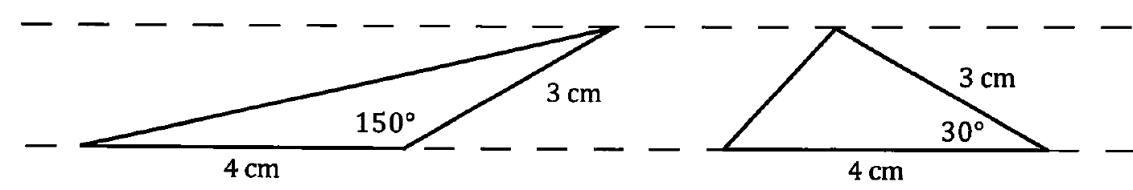
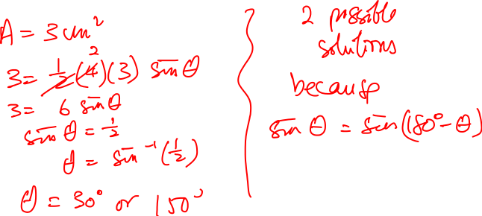
Find the angle C for the ΔABC given that a = 4 cm, b = 3 cm and the area of the ΔABC = 3 cm².

Slide 6
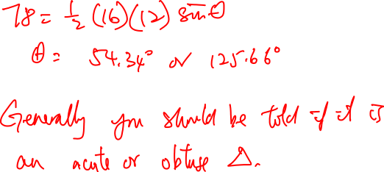
ΔABC is such that a = 16 cm, b = 12 cm. The area of the ΔABC = 78 cm². Find the angle ABC.

Slide 7
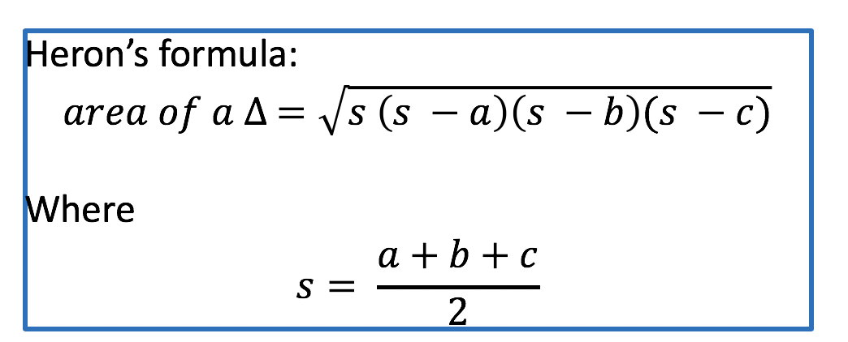
C
b
a
B
A
c

Slide 8
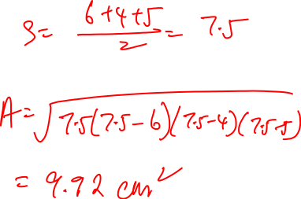
6 cm
4 cm
5 cm

Slide 9







Find the area of a ΔABC, two sides of which are 8 cm and 11 cm and the perimeter is 32 cm.

